Slide 1

Fifteen Puzzle
Project Team :
Sandeep Reddy
Venkata Prudhvi Raj
Gopesh Krishna Mohan

Slide 2
Description
The Fifteen Puzzle is a classic sliding puzzle game that consists of a 4x4 grid with numbered tiles. The objective is to arrange the tiles in numerical order from 1 to 15, with the empty space at the bottom right corner.
Initially, the tiles are shuffled randomly, creating a disordered configuration. You can move tiles into the empty space by sliding them horizontally or vertically, attempting to reposition the tiles sequentially until the numbers are ordered correctly.
The challenge lies in the limited movement—only adjacent tiles to the empty space can be moved at any given time. This limitation makes it necessary to strategize movements and plan ahead to solve the puzzle efficiently.

Slide 3
UML Diagram
nt
User
Home Page
Select Board Size
select image
start game
play game

Slide 4
Key Features
Background Tile image Selection
Selection of Board Size
Enabled Music through out the game
Enable/Disable Numbers on the image Tile
User can pause the game
Timer and Moves Display during Game.
Winner announcement with the time and number of moves
Animations

Slide 5
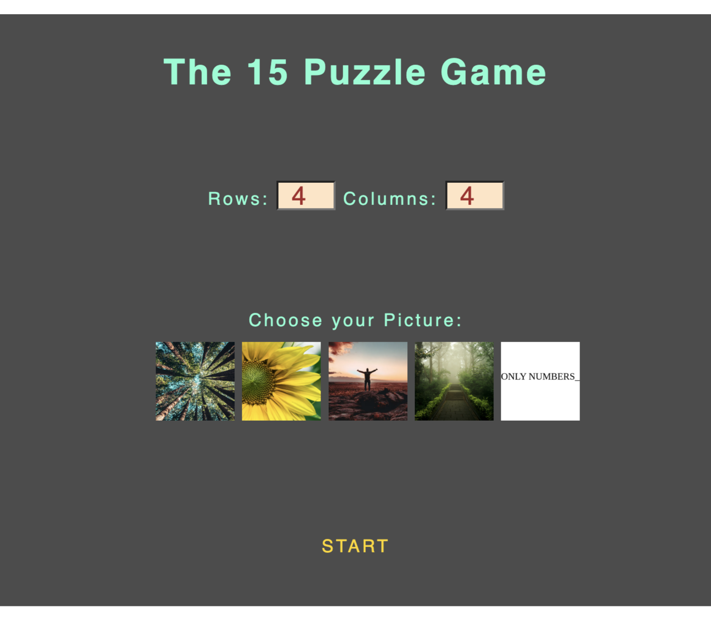
Application Home Page

Slide 6

Game Page

Slide 7
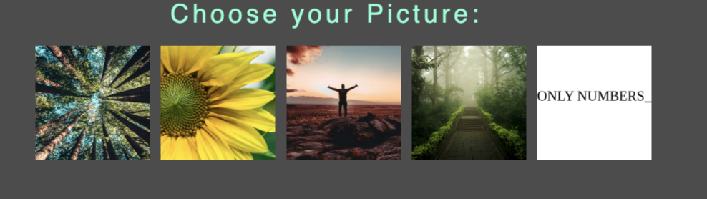
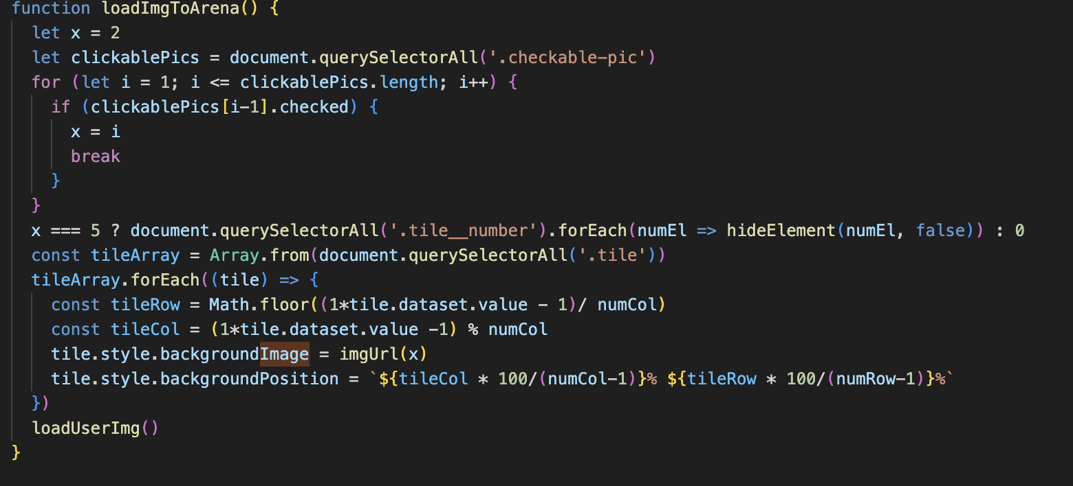
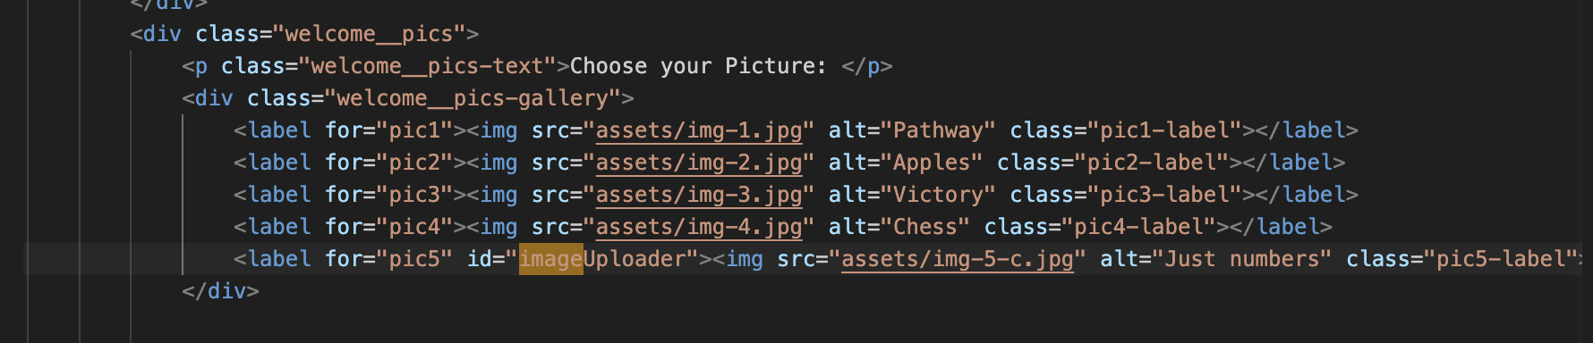
Background Tile Image Selection

Slide 8

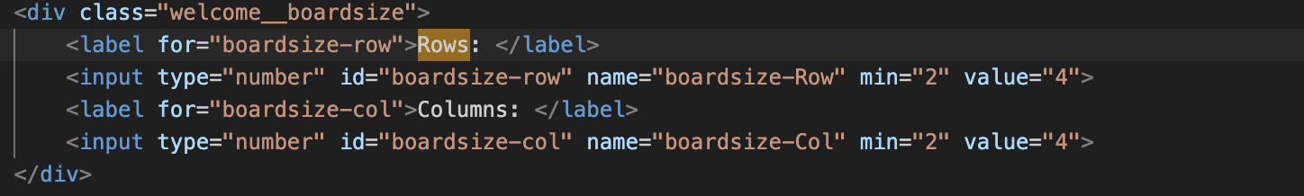
Selection of Board Size

Slide 9
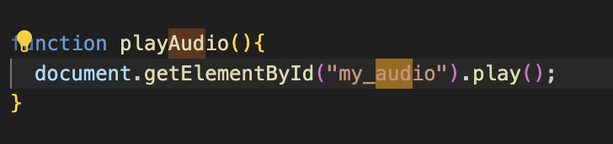
Enabled Music through out the game

Slide 10
Animations tile movement

Slide 11
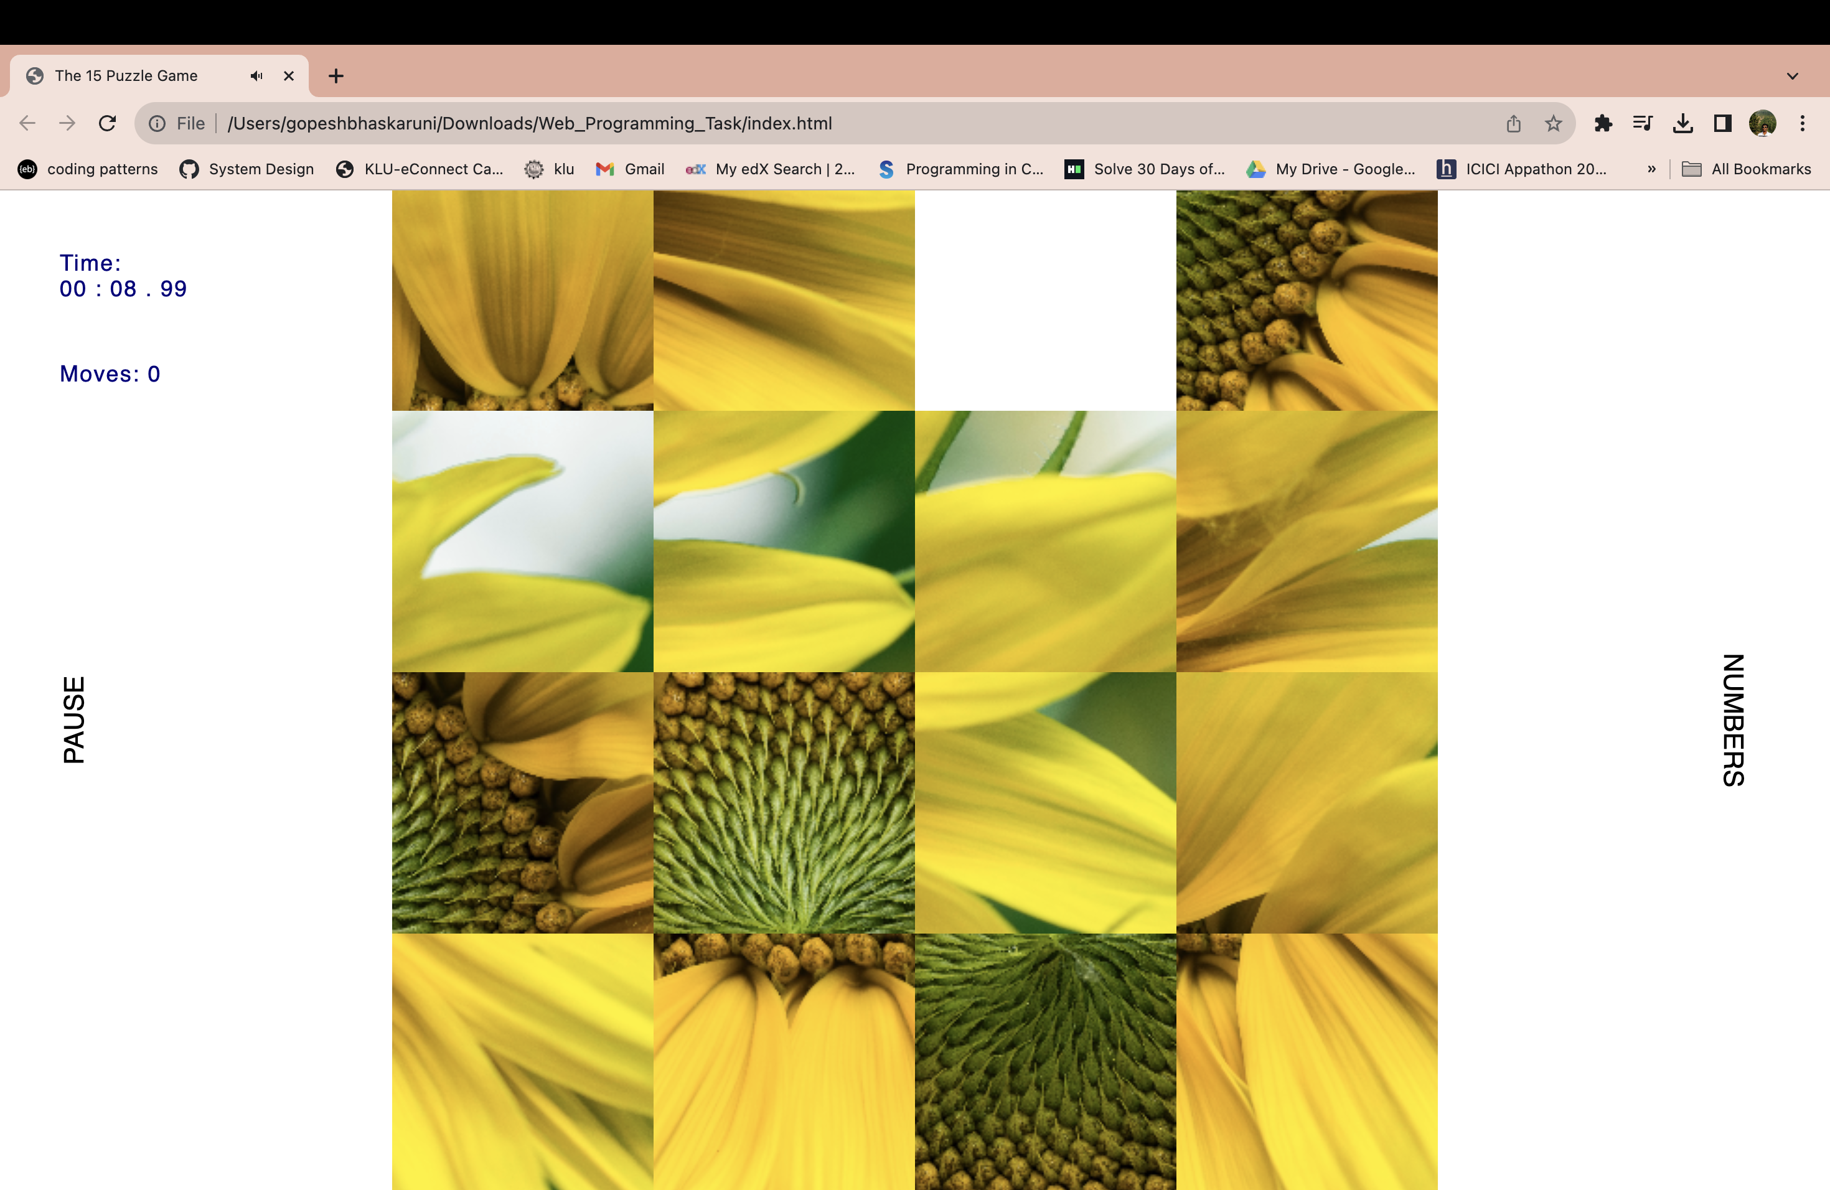

Enable/Disable Numbers on the image Tile

Slide 12
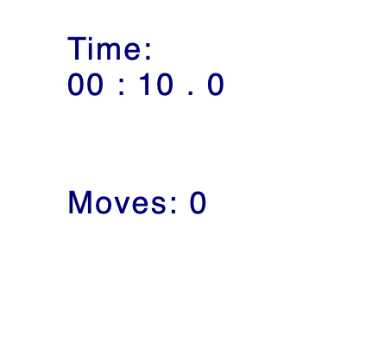
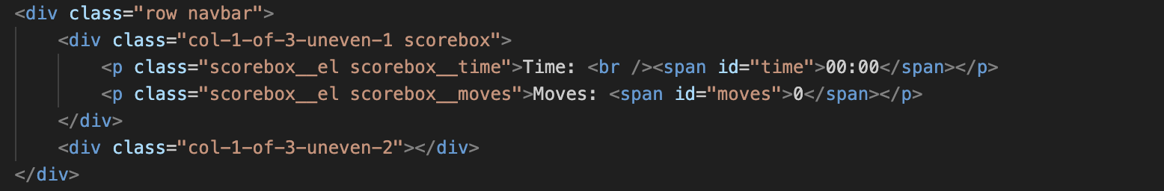
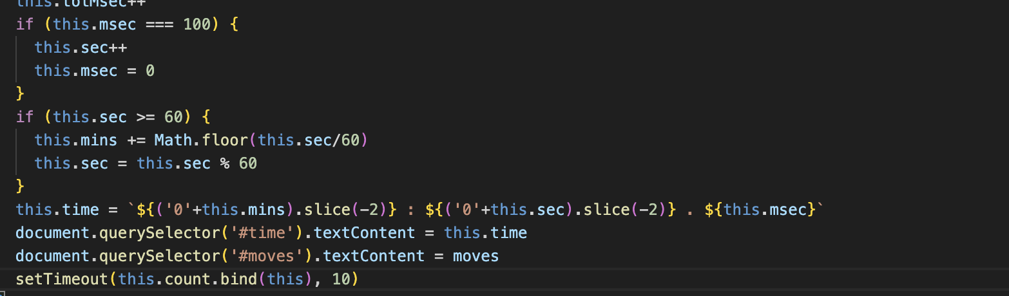
Timer and Moves Display during Game

Slide 13
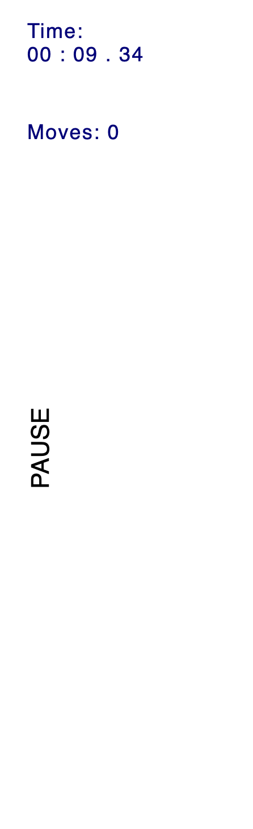
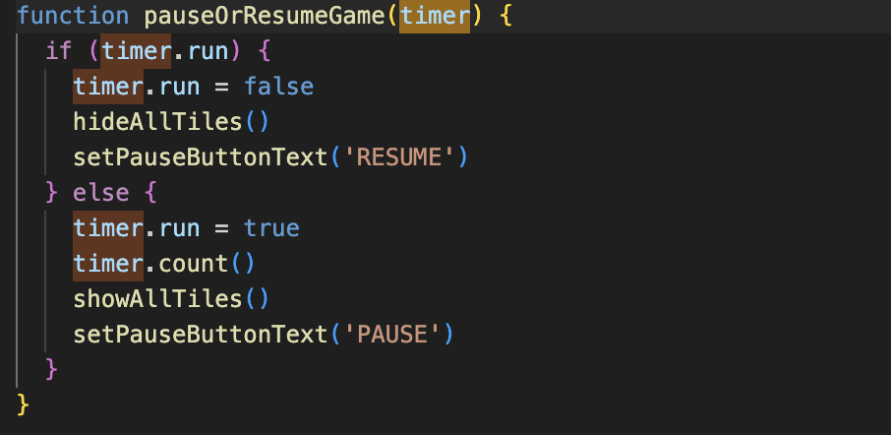
User can pause the game

Slide 14
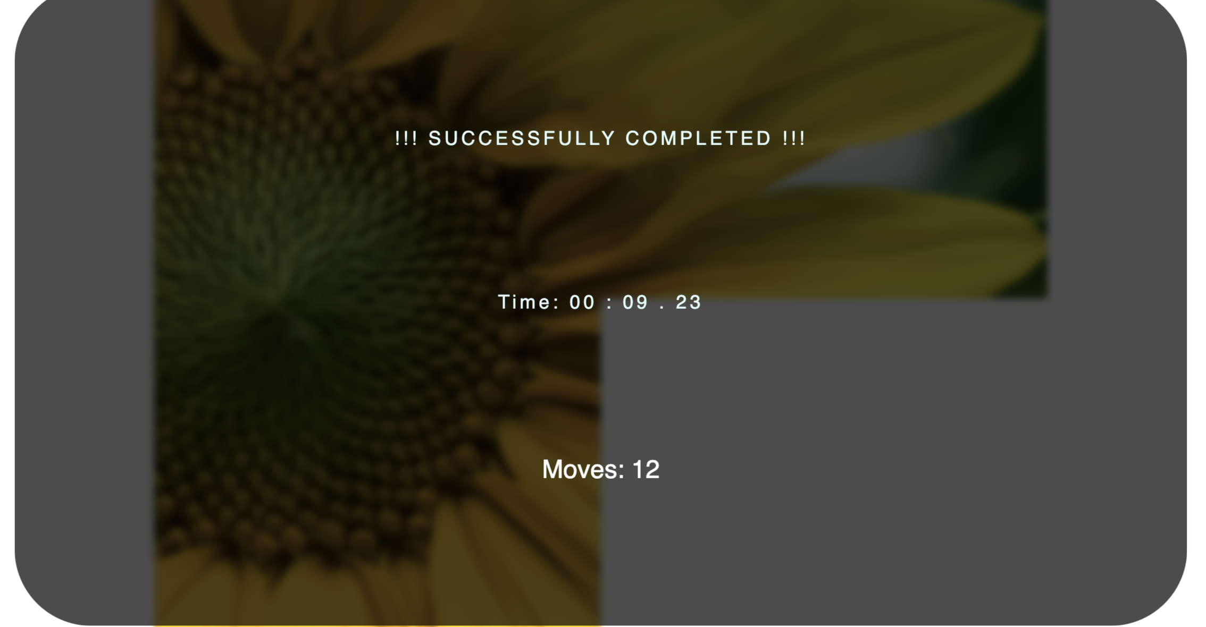
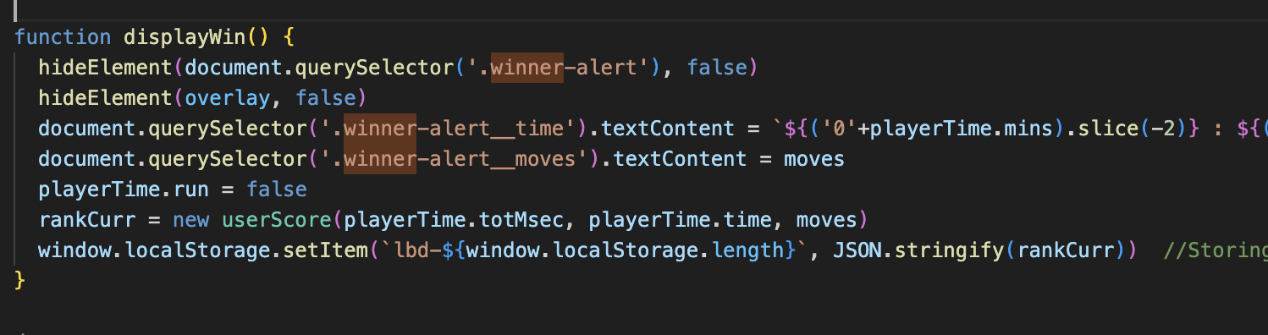
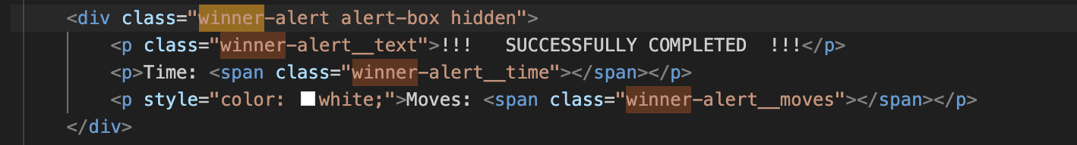
Winner announcement with the time and number of moves

Slide 15

Thank You

